Slide 1
Engineering Education and it’s impact on young graduates employability from students’ point of view
CLAIU-EU|Brussels March 2014

Slide 3
Vision and Mission
[
]
Empowered Diversity
Developing Students

Slide 4
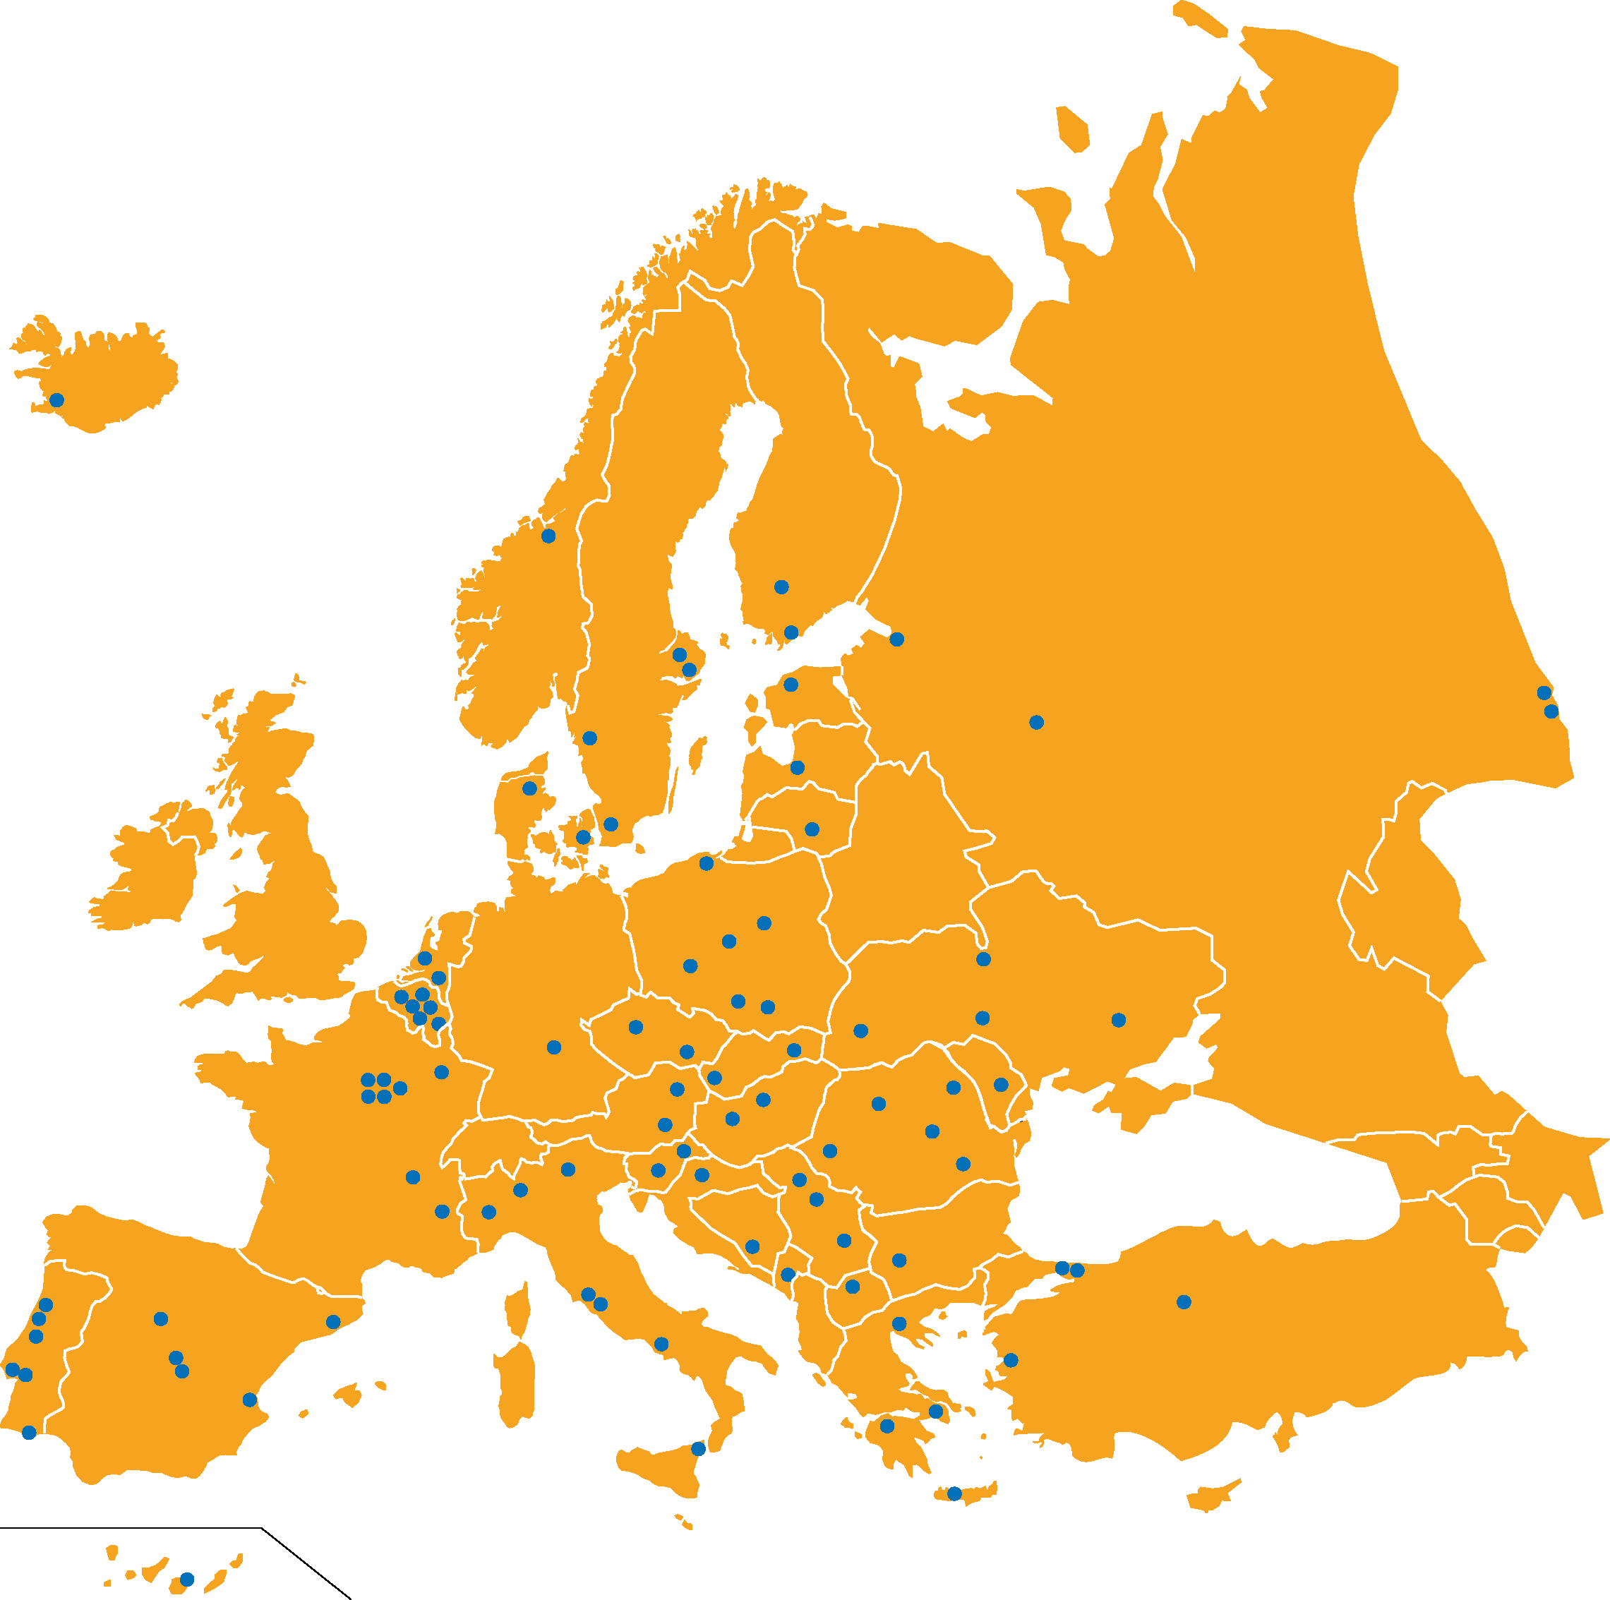
[
]
33 Countries 96 Local Groups
3,300 Members 1,3 million Students

Slide 5
Students
Universities
Companies

Slide 6
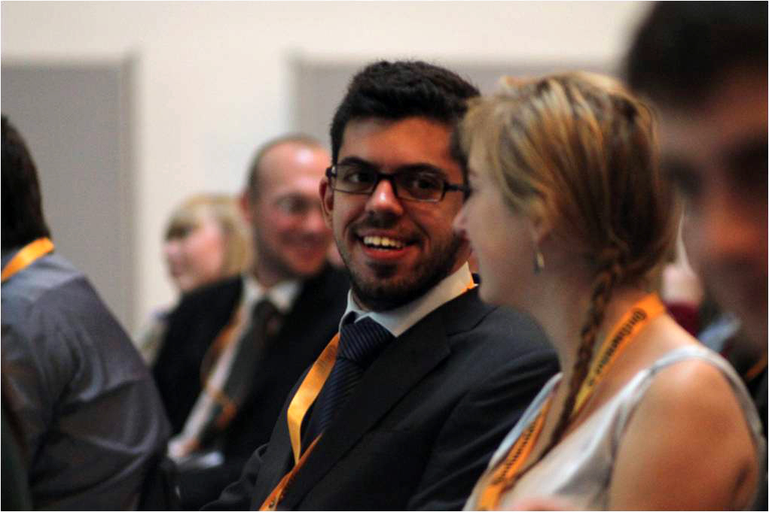
[
]
Complementary Education
Educational Involvement
Career Support

Slide 7
BEST Educational Involvement

Slide 8
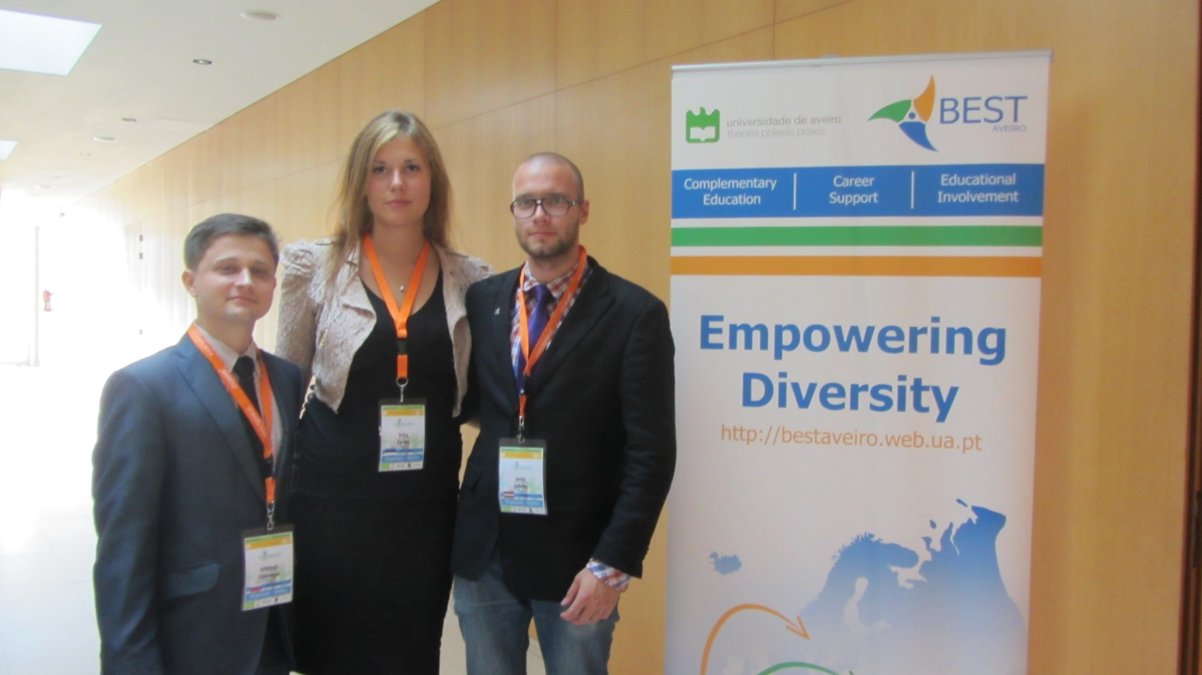
Educational Committee
“
To increase technology students awareness of educational matters, in order to help students with their self-development.
”

Slide 9
Educational Committee
“
To transmit input on educational matters to European higher education stakeholders by collecting individual opinions from students, the academic world and companies.
”

Slide 10
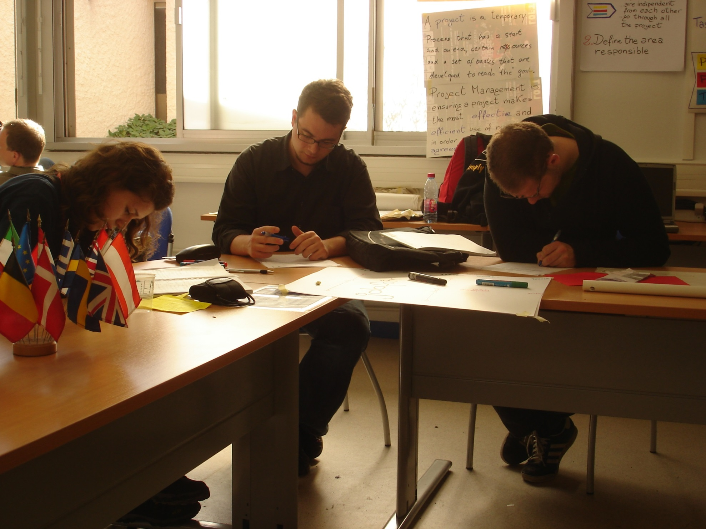
[
]
Evolution of European Engineering Education
Gathering engineering students and professors
Discuss current issues related to education
Evaluating and discovering new paths for education

Slide 11
gap

Slide 12
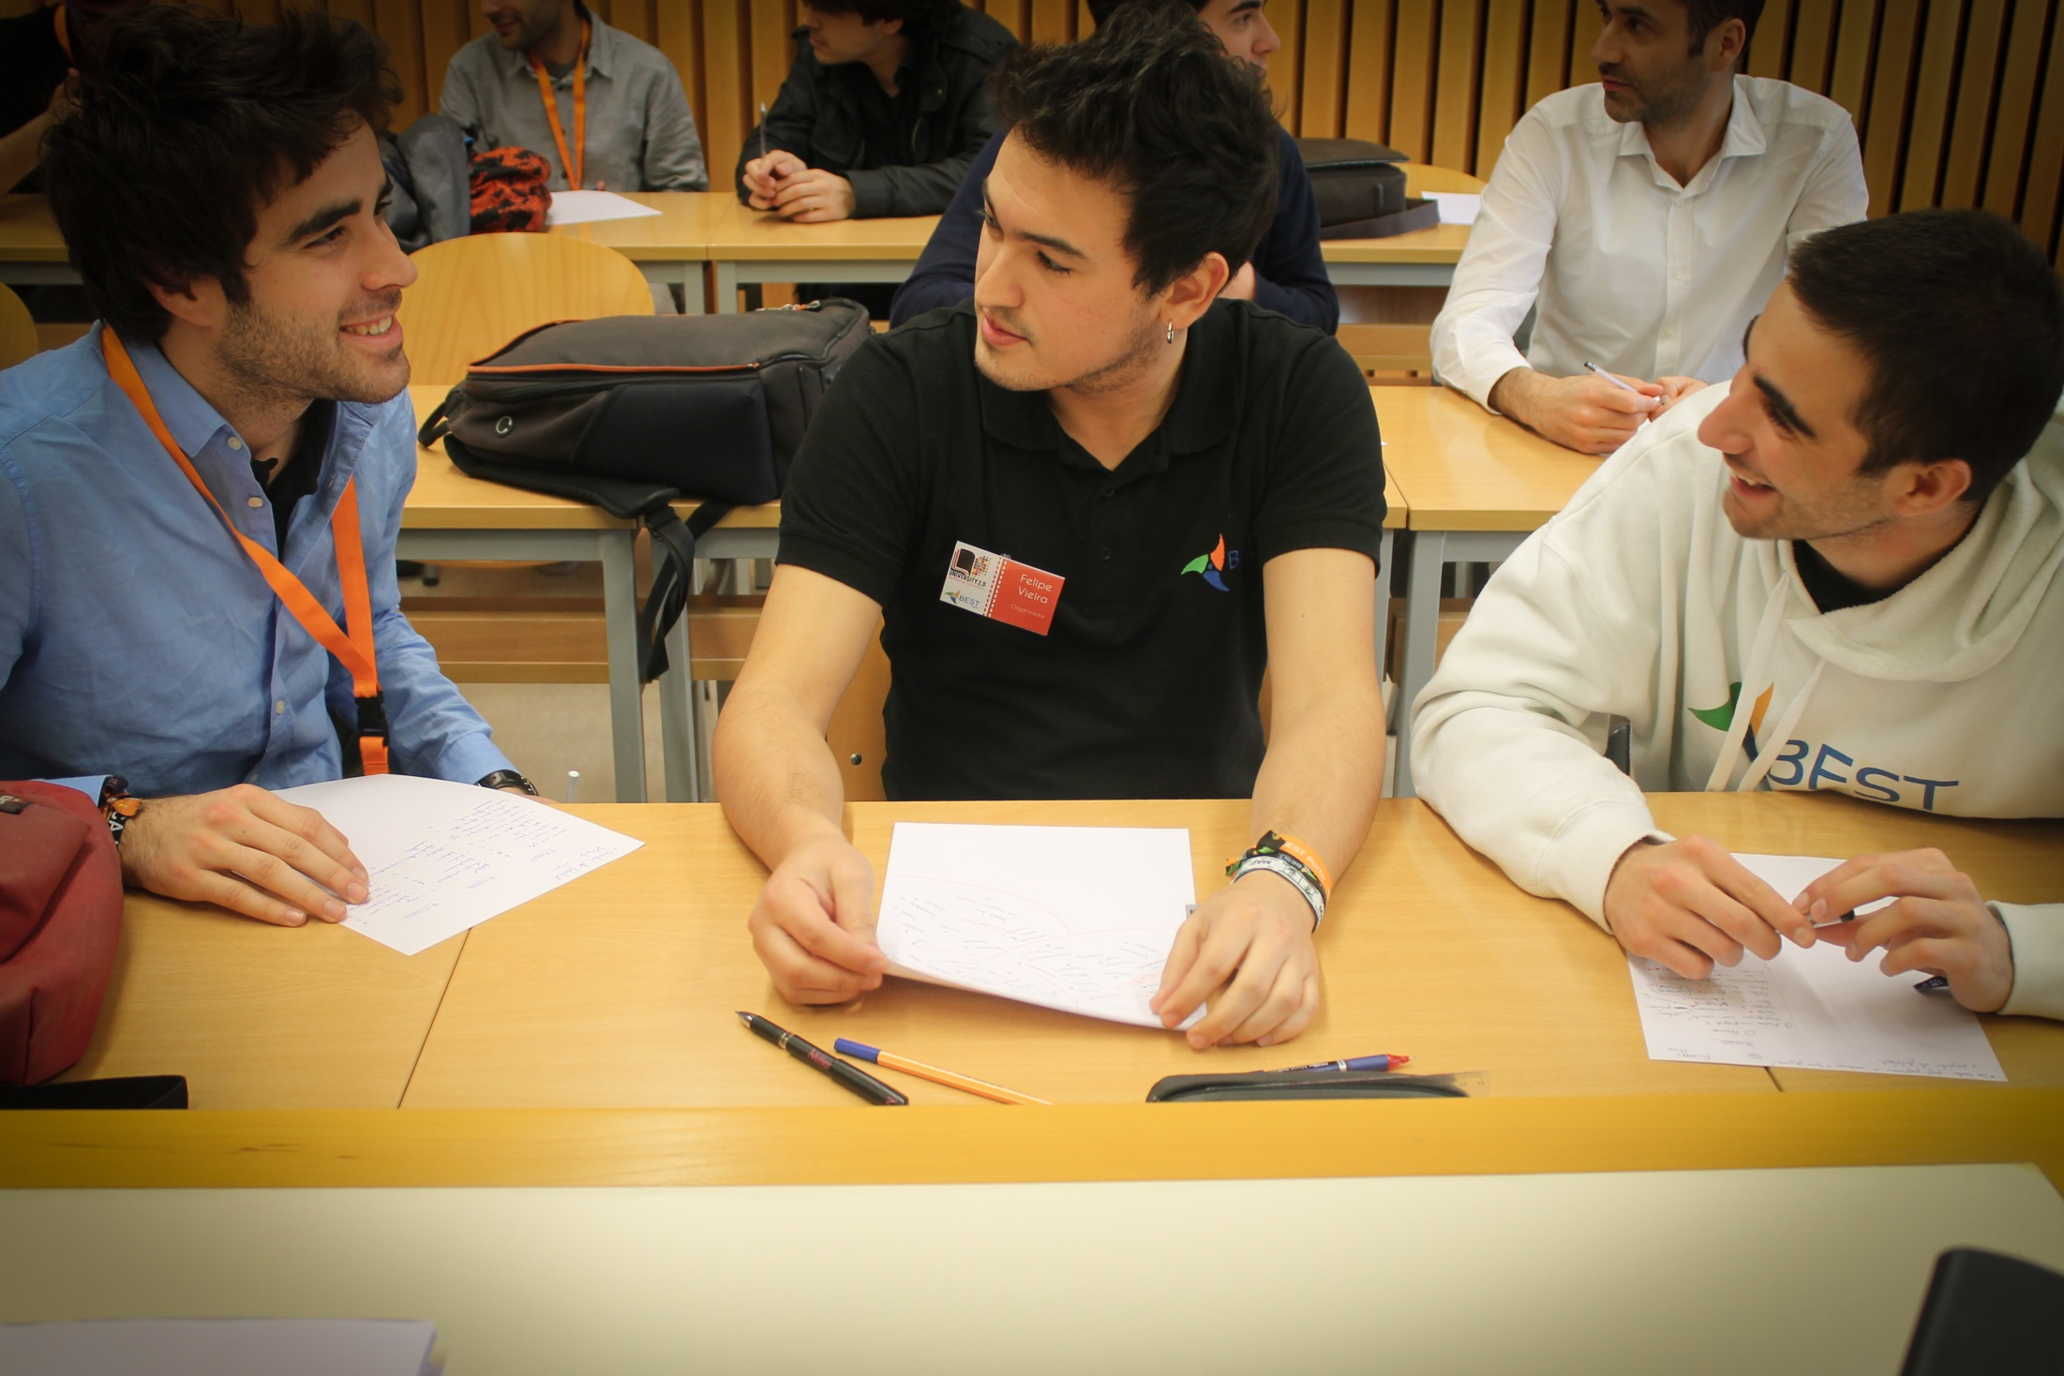
[
]
BEST Academics and Companies Forum
BEST Symposium on Education

Slide 13
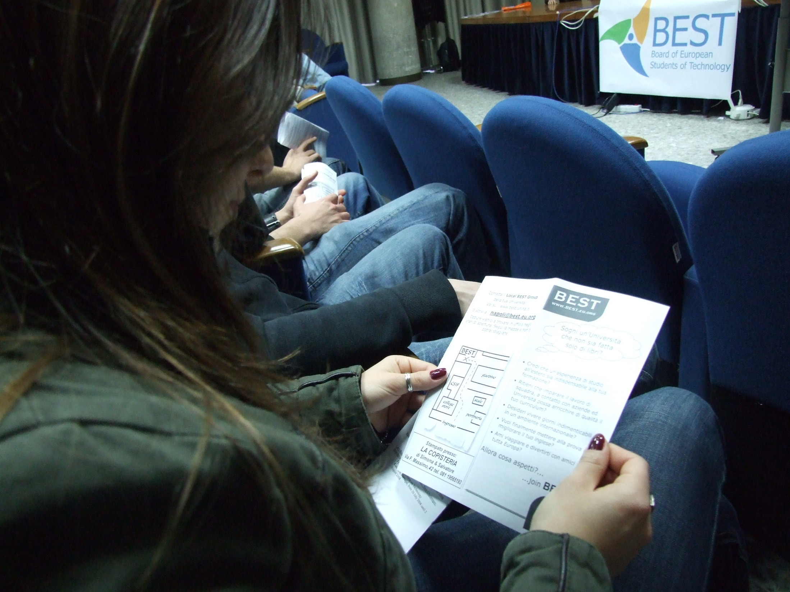
[
]
BACo Rome Tor Vergata 2005
BACo Istanbul 2006
BACo Sofia 2010
BACo Timisoara 2013
Symposium on Education Aveiro 2013
Survey EBEC Final

Slide 14
BACo Rome Tor Vergata 2005
26th July - 1st August 2005
“The Role of Extra-Curricular Activities in the Formation of Engineers”

Slide 15
BACo Rome Tor Vergata 2005
Outcomes:
a diploma is not enough for employability
the recognition of extra-curricular activities is necessary
extra-curricular activities provide documentation for future employers, increase student’s motivation and increase options to customise University experience.

Slide 16
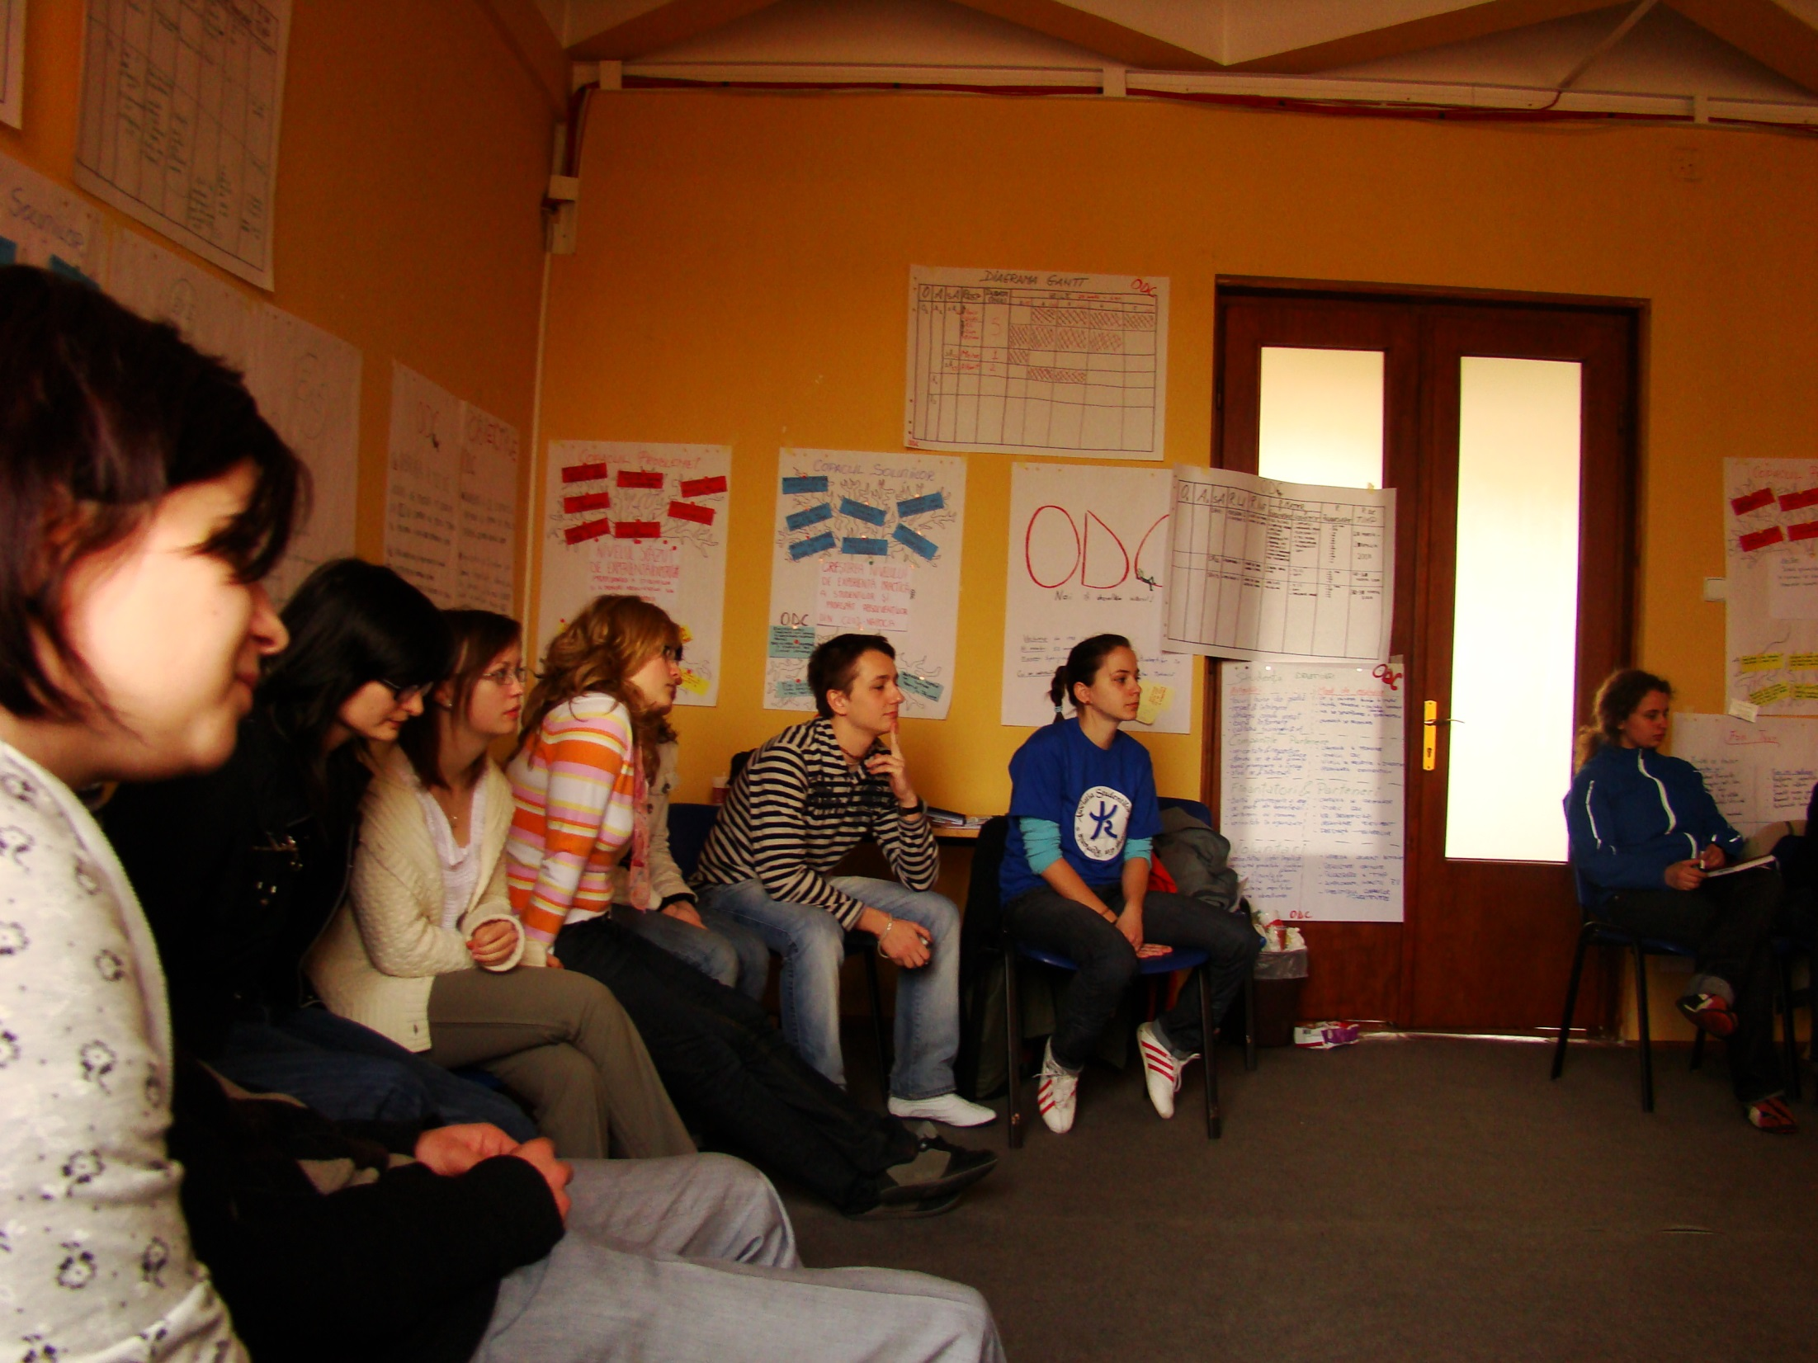
BACo Istanbul 2006
27th February - 5th March 2006
“Accreditation, learning outcomes and the role of extra-curricular activities in the formation of engineers.”

Slide 17
BACo Istanbul 2006
Outcomes:
grades are not always indicative of the level of knowledge or ability to act as an engineer
university is not enough to be an engineer
soft skills are indispensable for the profile of every engineer
companies should get more involved in university programmes

Slide 18
BACo Sofia 2010
20th - 28th August 2010
“University is not enough? Cross the bridge to the real world!”
importance of internships and mentorship for students development

Slide 19
BACo Sofia 2010
Outcomes:
internships turn theoretical knowledge into practice
internships give an insight into working-methods
internships contribute to adapt the students mindset closer to their future needs
mentorship is an helpful tool for future engineers to develop the right skills

Slide 20
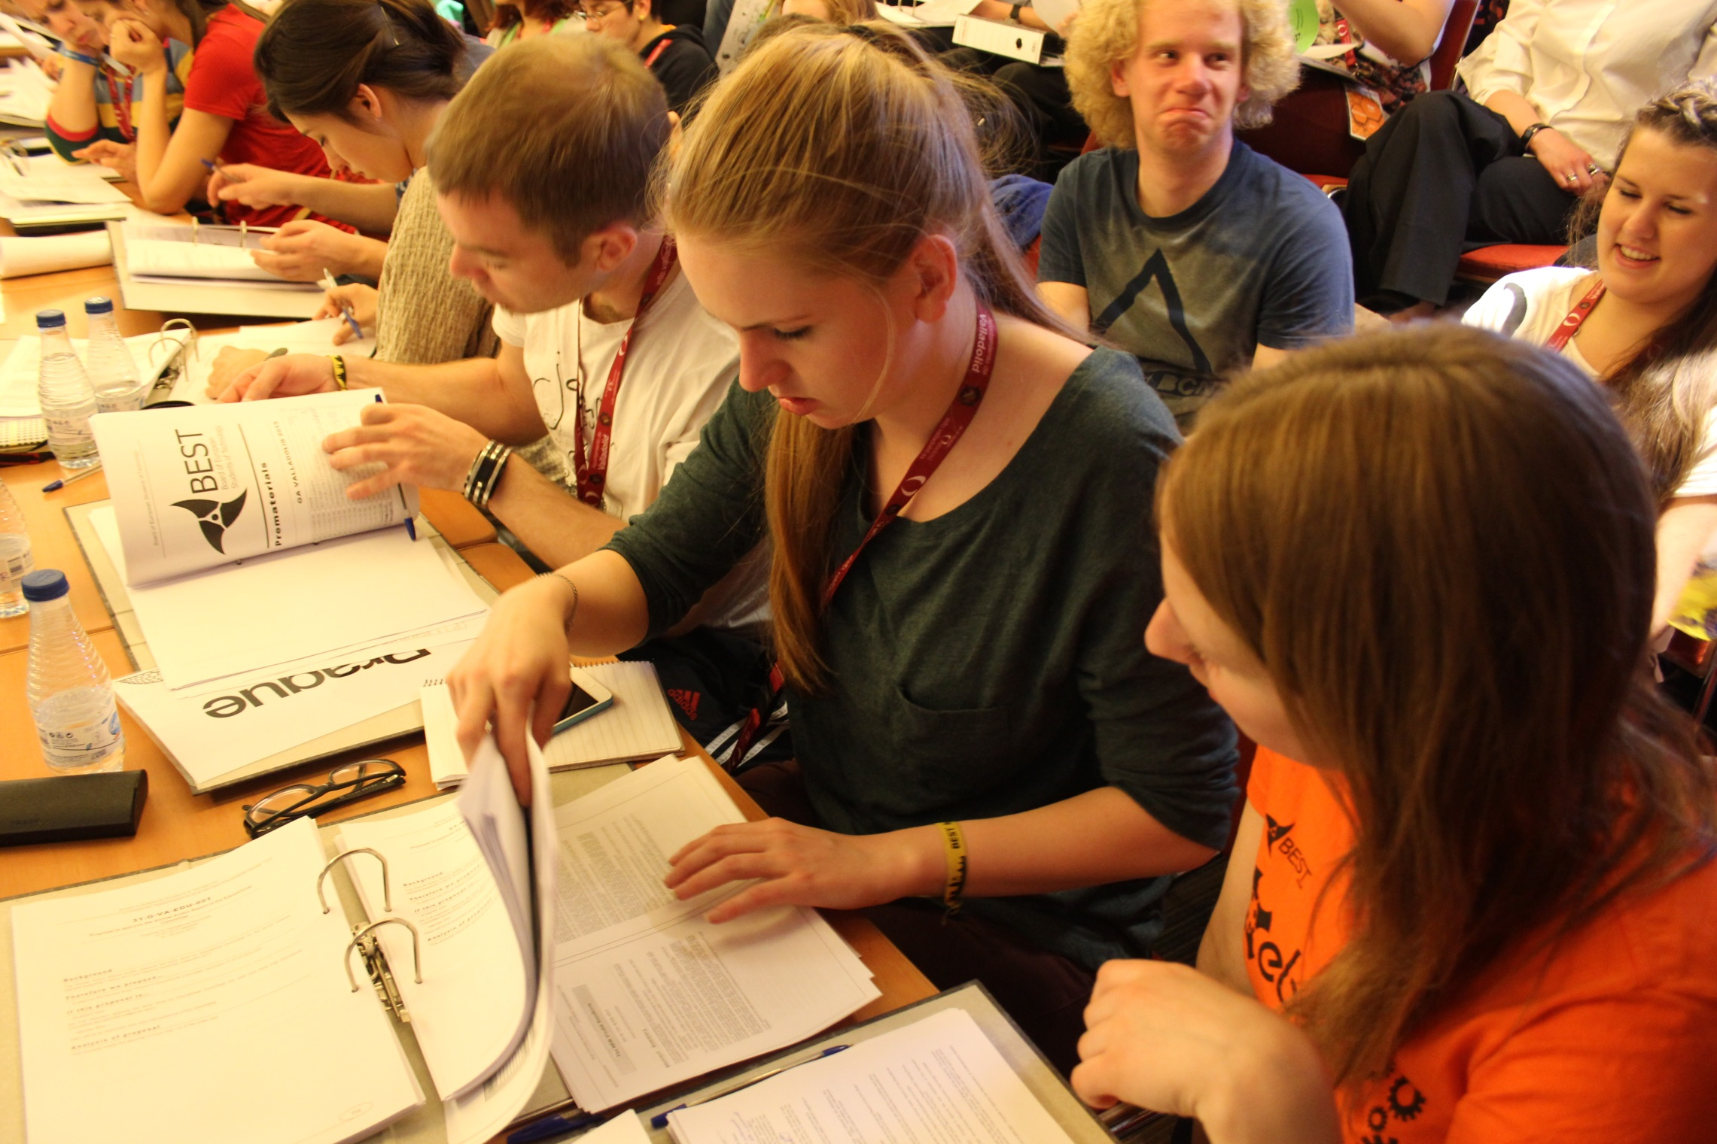
BACo Timisoara 2013
14th - 20th July 2013
“Bringing Education and Entrepreneurship under students’ scope”
two subtopics: Virtual internships (within PROVIP project) and Enterpeneurship.

Slide 21
BACo Timisoara 2013
Outcomes:
getting an internship generally leads to a job
Internships develop soft skills such as communication skills, networking, and time management
virtual internships should promote the interaction between stakeholders (universities, students and companies)

Slide 22
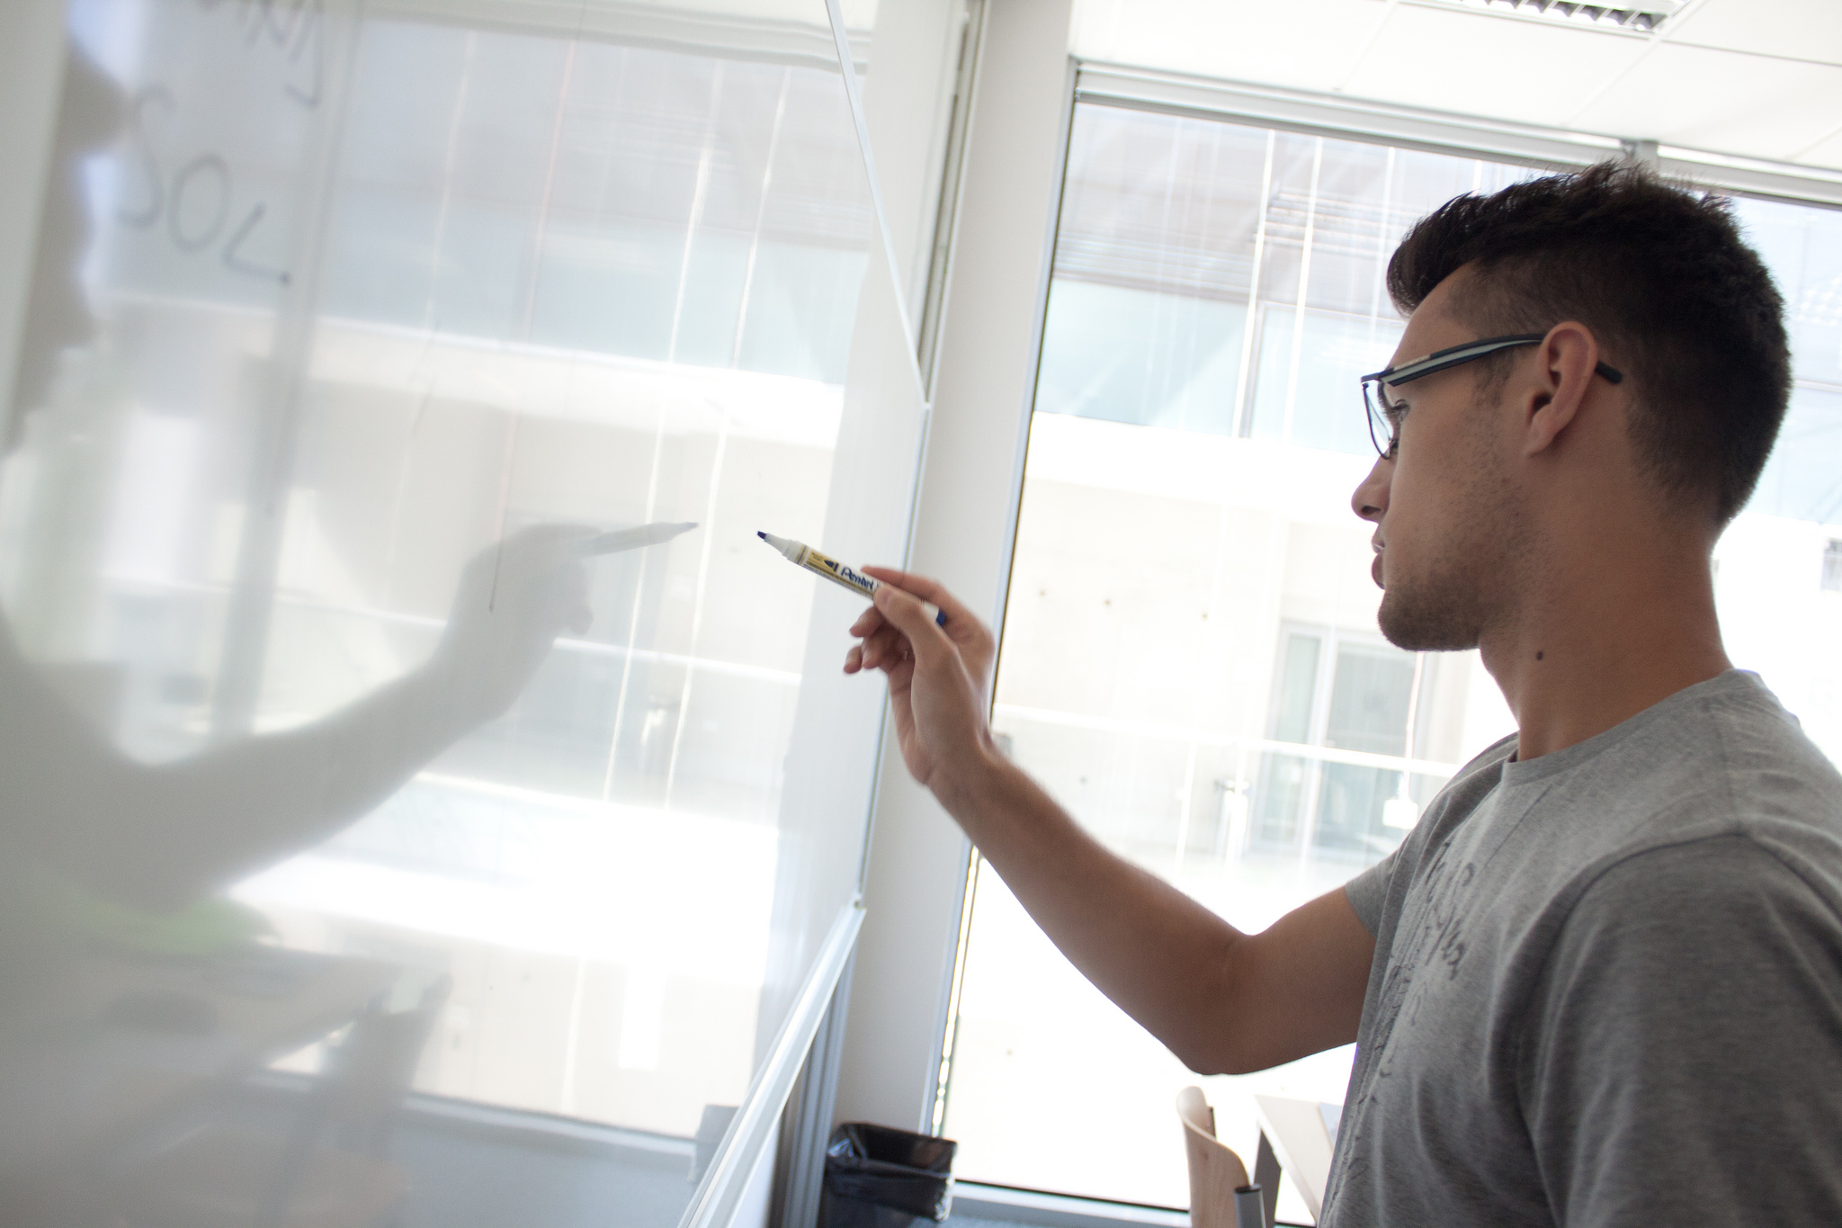
Symposium on Education Aveiro 2013
30th August - 8th September 2013
“Accreditation and attractiveness in engineering”

Slide 23
Symposium on Education Aveiro 2013
Outcomes:
soft skills in addition to the “hard skills” increase employability
nowadays employers are looking for soft skills in addition to the standard qualifications
there should be a supervision system including all the stakeholders which would evaluate and supervise the university curricula

Slide 24
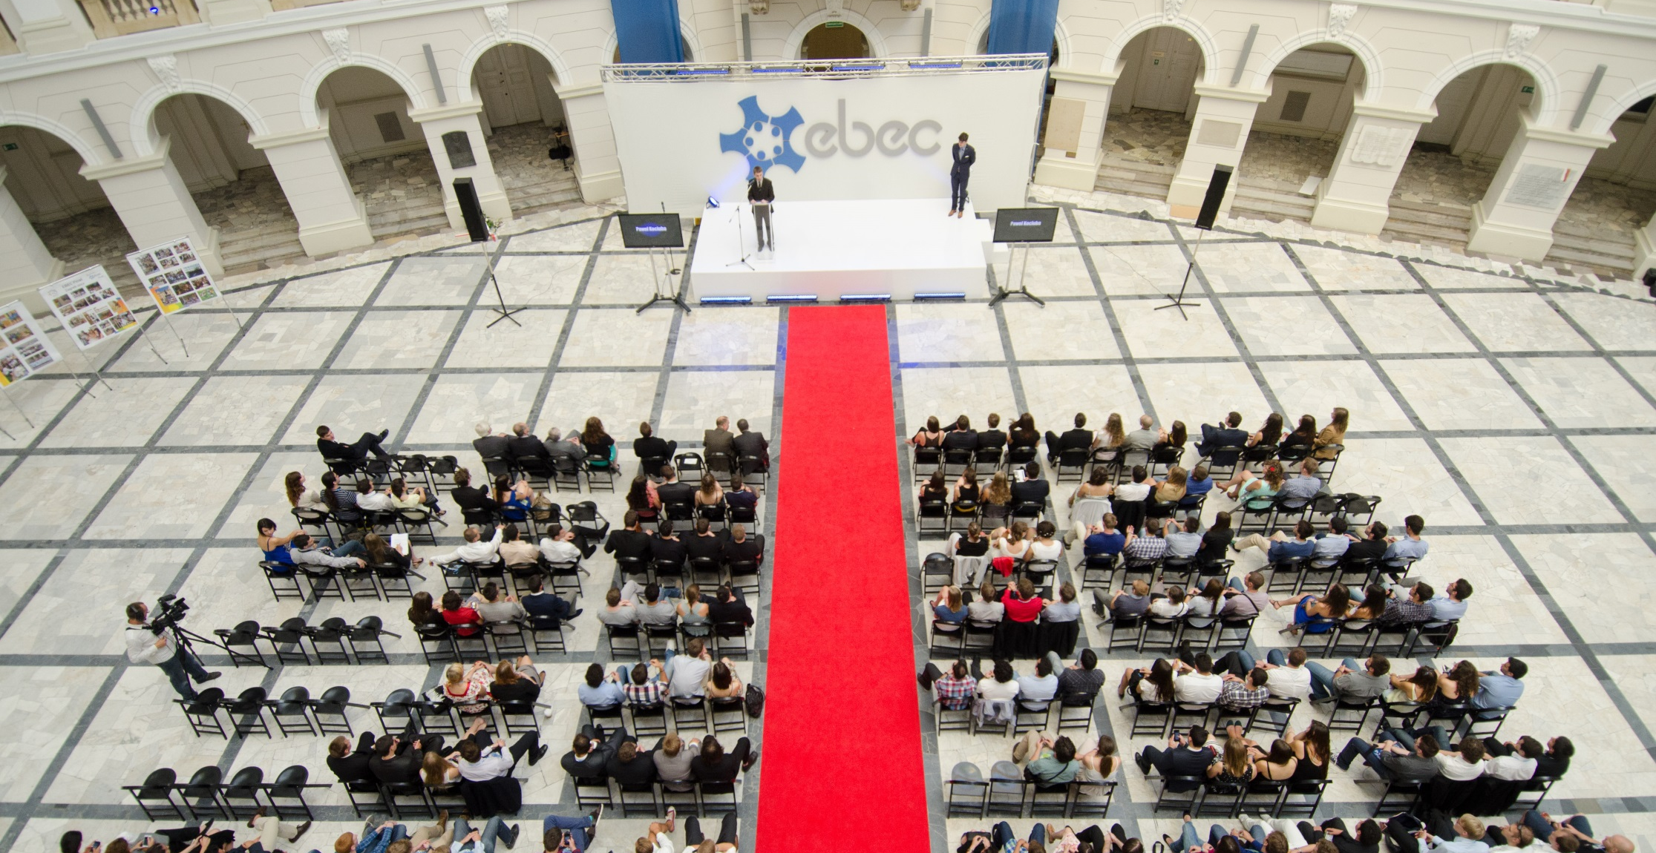
Survey EBEC Final
EBEC Finals 2011 (Istanbul) and 2012 (Zagreb)
European BEST Engineering Competition

Slide 25
Survey EBEC Final
Outcomes:
interest of academics, industry and students greatly overlap in the course of EBEC
skills required by the industry are acquired or improved during students’ participation in engineering competitions
participating increases as student awareness of soft skills importance

Slide 26
There are several opportunities to brigde the gap between employers needs and the skills and knowledge provided by education
extra-curricular education
development of soft skills
internships
mentorship

Slide 27
The work of organizations like BEST in improving students’ curricula
development of extra-curricular education
promotion of soft skills recognition
promotion of students’ involvement in EEE

Slide 28
Students
Universities
Companies
Debate with stakeholders:
Holistic approach to the development of engineering students curricula for the sake of future generations of engineers

Slide 29
Thank you!
Marta Cortesão

